Slide 1
What is the Internet doing to me?
(Security and privacy for people in a
connected world)
Some legal issues
Classes 2&3; 7&11 October 2022
Copyright & Censorship
Dr Eoin O’Dell @cearta

Slide 2

Copyright
?
So, just what is
; image: https://www.flickr.com/photos/mikeblogs/3020135605/

Slide 3
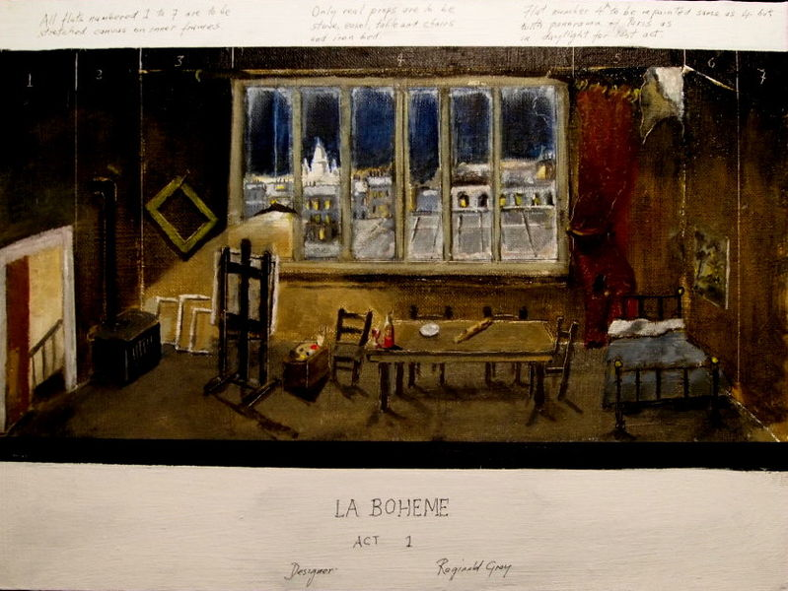
Copyright
; image: https://commons.wikimedia.org/wiki/File:La_Boheme_Act1_by_Gray.jpg

Slide 4
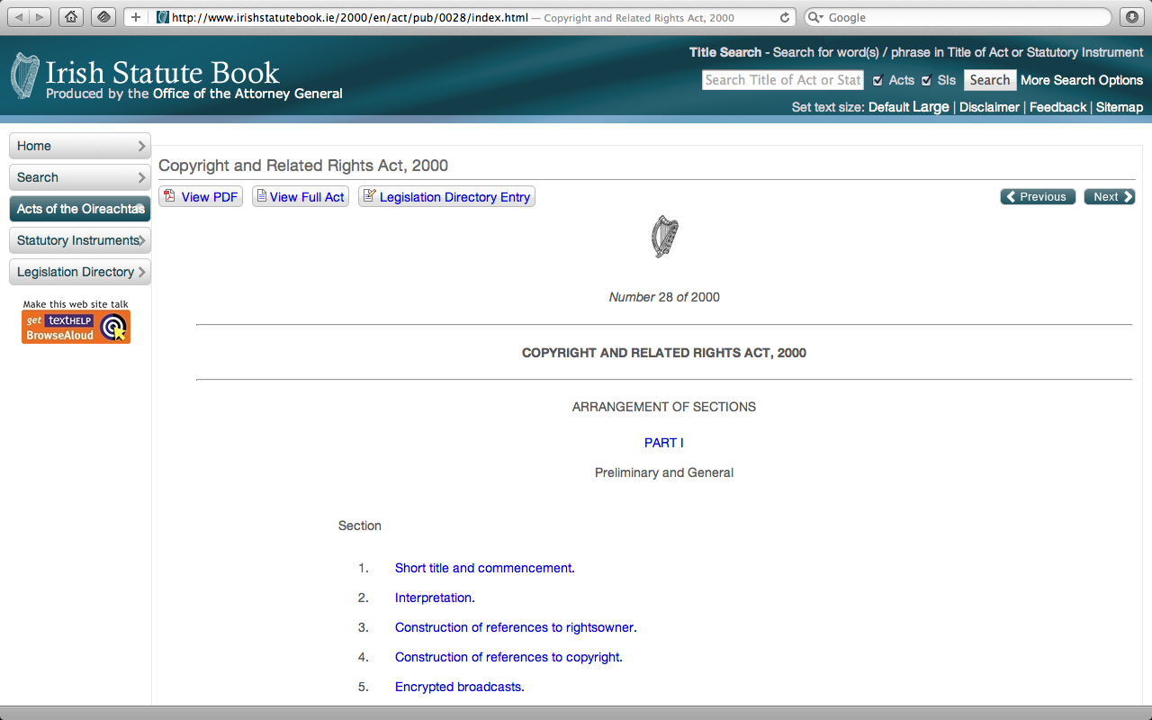
Copyright and Related Rights Act, 2000
; image:http://www.irishstatutebook.ie/2000/en/act/pub/0028/index.html

Slide 5
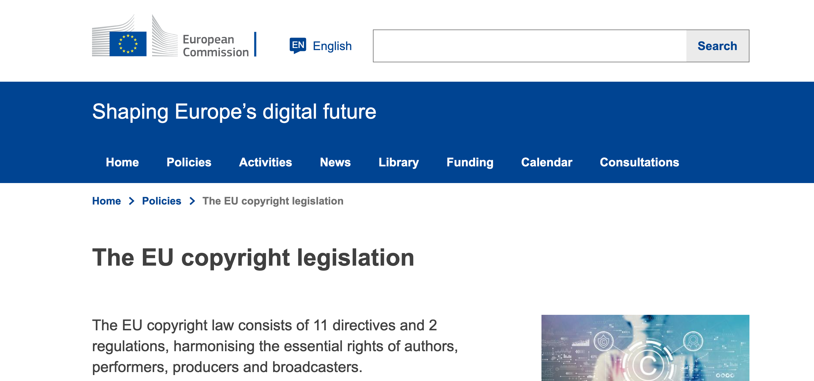

EU Copyright acquis
InfoSoc Directive 2001/29/EC (22 May 2001)
Copyright DSM Directive (EU) 2019/790 (17 April 2019)
; image: https://commons.wikimedia.org/wiki/File:La_Boheme_Act1_by_Gray.jpg

Slide 6

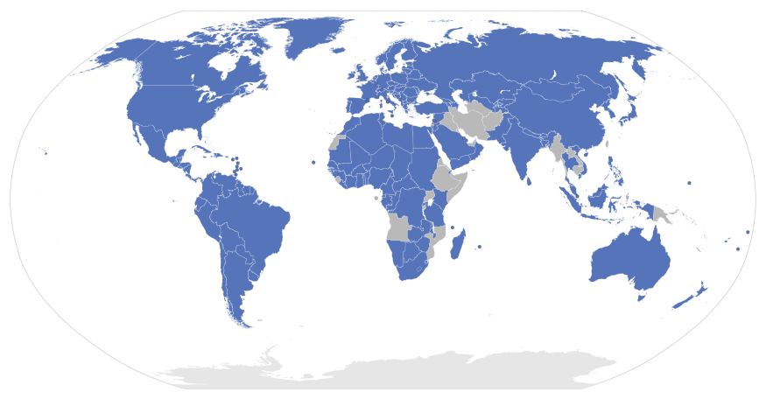
International Conventions
Berne since 1886
Marrakesh 2013
; image: http://upload.wikimedia.org/wikipedia/commons/7/76/Berne_Convention_signatories.svg http://www.clker.com/clipart-red-pin-no-shadow.html

Slide 7
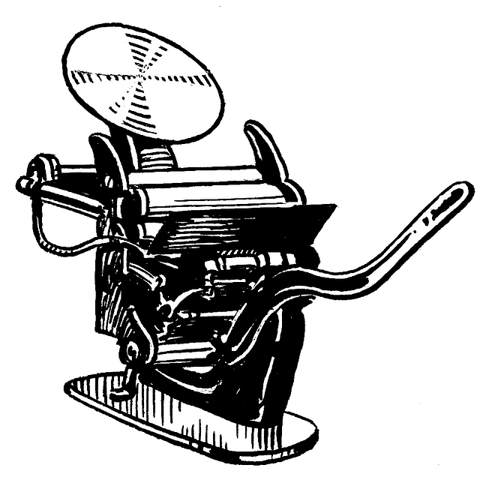





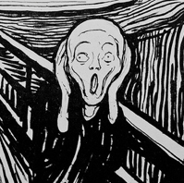
Copyright Community
©
; image:

Slide 8


Section 17(2)(a) CRRA
original
literary
dramatic
musical
artistic
works
; image: https://www.flickr.com/photos/artofchilling/5693120074/in/photostream/

Slide 9
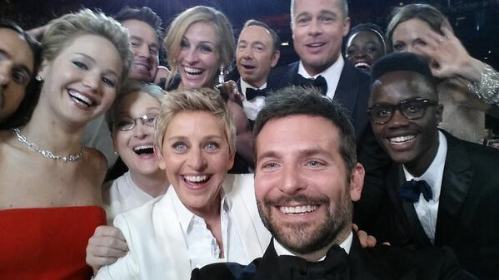
Section 17(2)(a) CRRA
Oscars 2014
; image: https://twitter.com/TheEllenShow/status/440322224407314432

Slide 10
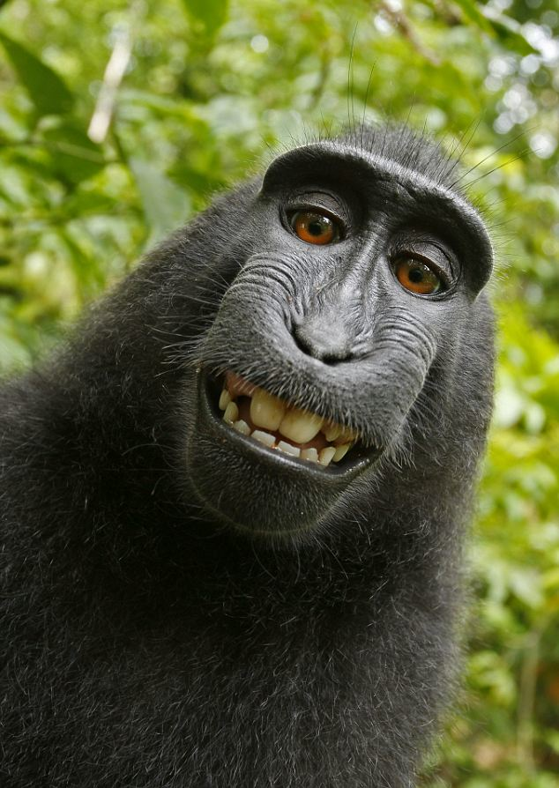
Section 17(2)(a) CRRA
; image: http://en.wikipedia.org/wiki/Selfie#mediaviewer/File:Macaca_nigra_self-portrait.jpg

Slide 11
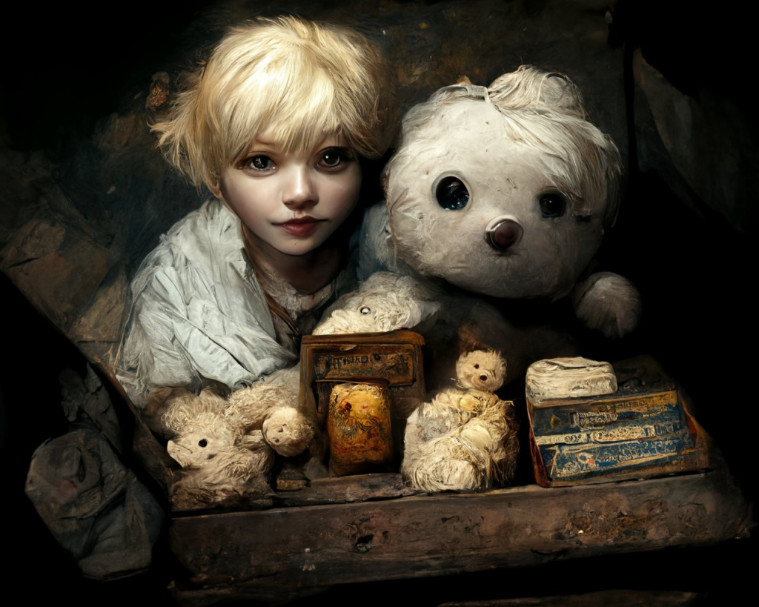
Section 17(2)(a) CRRA
; image: http://en.wikipedia.org/wiki/Selfie#mediaviewer/File:Macaca_nigra_self-portrait.jpg & https://ceoln.wordpress.com/2022/10/01/ai-art-and-copyright-some-more/

Slide 12
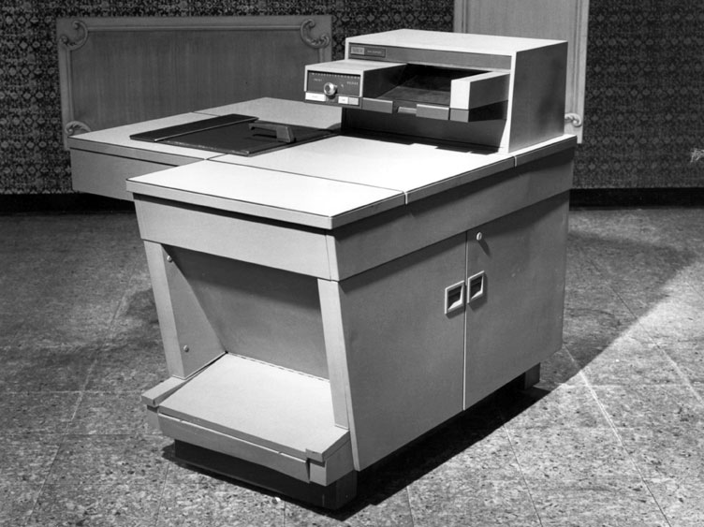
Section 37(1) CRRA
copy
make
available
adapt
; image: http://en.wikipedia.org/wiki/File:Xerox_914.jpg

Slide 13
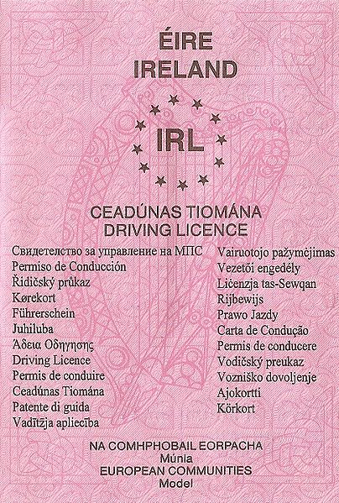
Section 37(1) CRRA
copy
make
available
adapt
; image: https://commons.wikimedia.org/wiki/File:Irish_Drivers_Licence.jpg

Slide 14
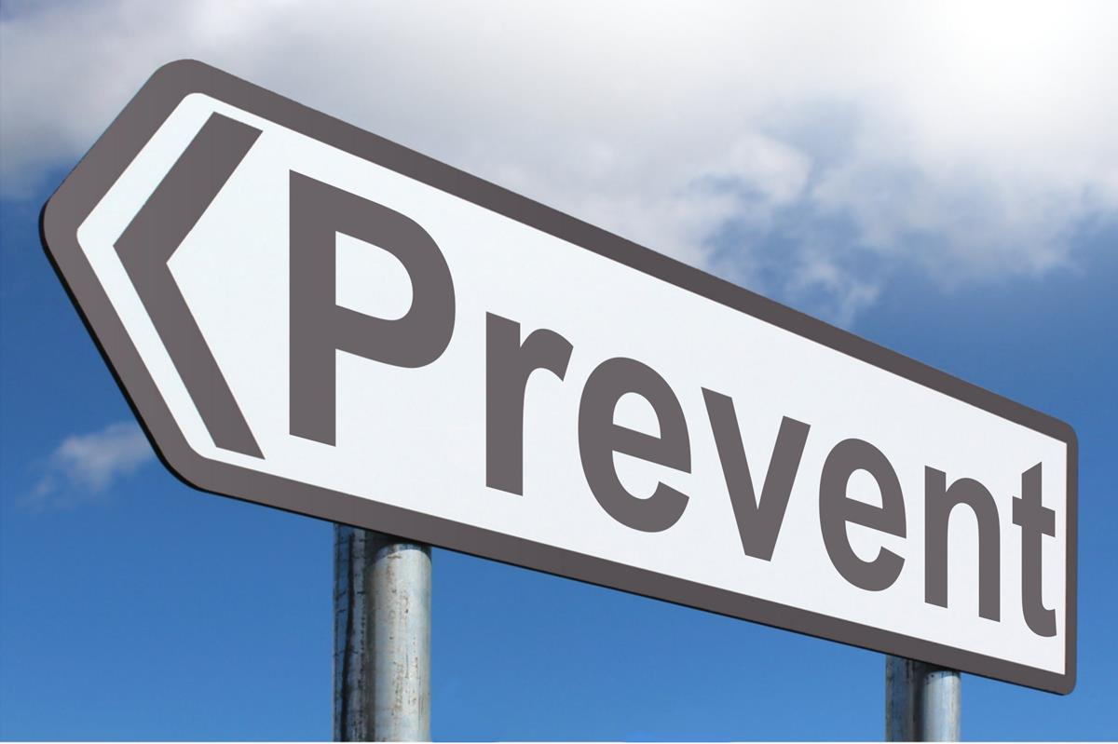
Section 37(1) CRRA
copy
make
available
adapt
; image: https://www.picpedia.org/highway-signs/p/prevent.html

Slide 15

Reusing copyright material
Q When can you use other people’s content?
A Old
Public Domain
Public sector data
Permission
Licences
Exceptions
Links
; image: https://www.picpedia.org/highway-signs/p/prevent.html

Slide 16
Reusing copyright material
Q When can you use other people’s content?
A Old
Public Domain
Public sector data
Permission
Licences
Exceptions
Links
; image: https://www.picpedia.org/highway-signs/p/prevent.html

Slide 17
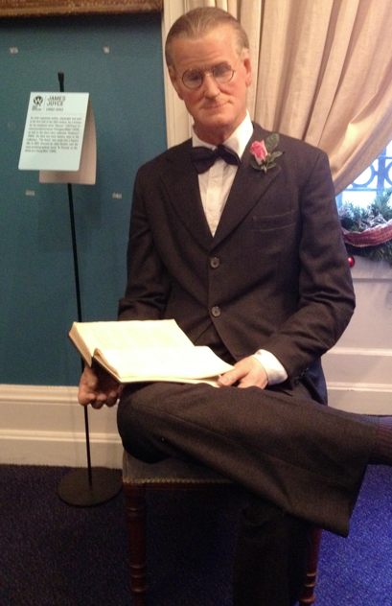
Section 24(1) CRRA
life of
author
plus
70
years
(in the EU)
James Joyce died
13 January 1941
; image: http://www.cearta.ie/wp-content/uploads/2012/01/JoyceNWM.jpg

Slide 18

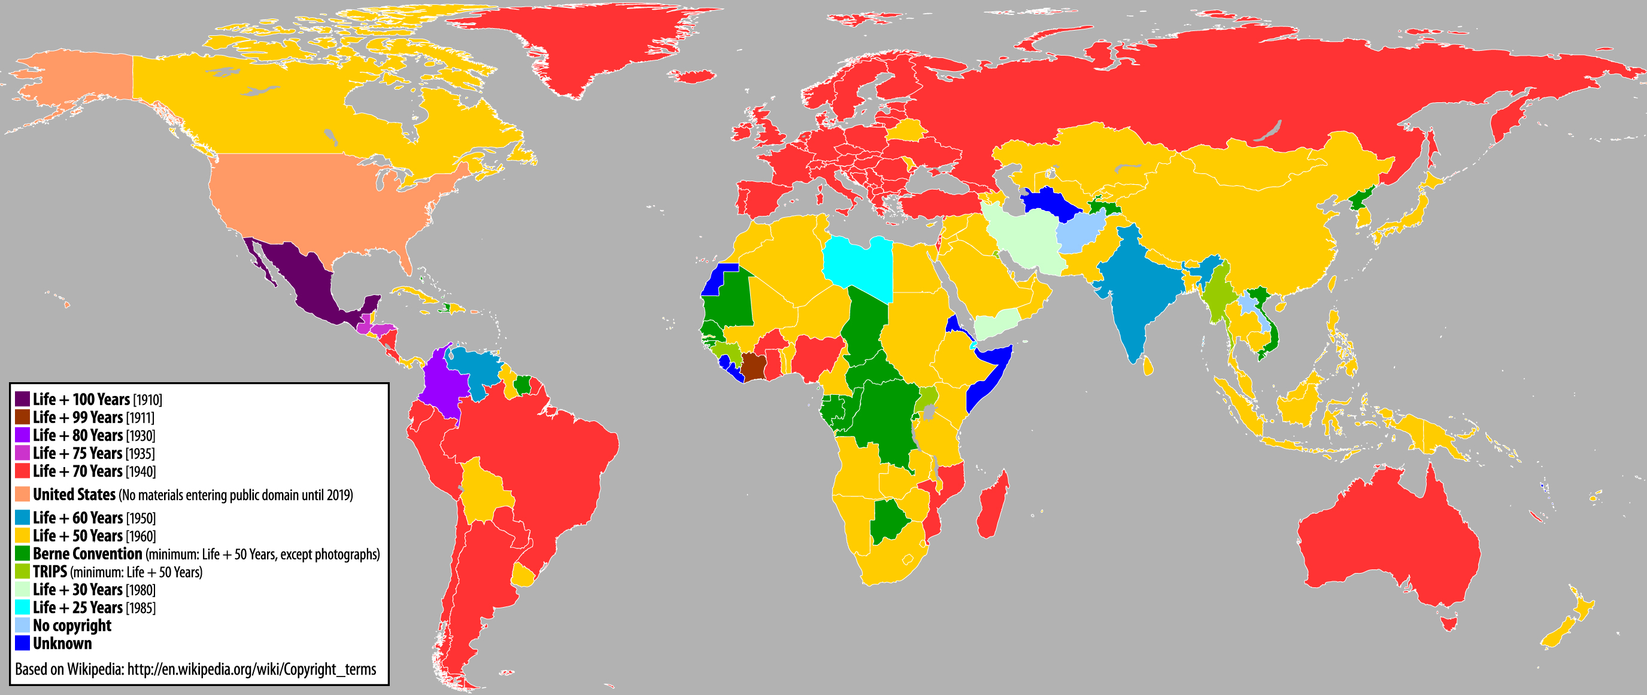
Section 24(1) CRRA
Life plus ≥90
Life plus 50 Life plus 70
; image: http://www.publicdomainday.org/sites/www.publicdomainday.eu/files/World_copyright-terms.jpg

Slide 19
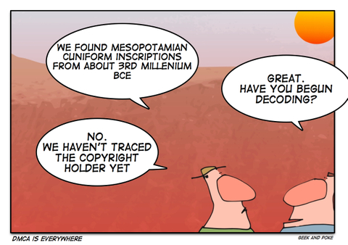
Section 24(1) CRRA
; image: http://geek-and-poke.com/geekandpoke/2006/10/15/copyright-and-academic-freedom.html

Slide 20
Reusing copyright material
Q When can you use other people’s content?
A Old
Public Domain
Public sector data
Permission
Licences
Exceptions
Links
; image: https://www.picpedia.org/highway-signs/p/prevent.html

Slide 21
Reusing copyright material
Q When can you use other people’s content?
A Old
Public Domain
Public sector data
Permission
Licences
Exceptions
Links
; image: https://www.picpedia.org/highway-signs/p/prevent.html

Slide 22


Reusing copyright material
≠
; images: http://commons.wikimedia.org/wiki/File:Internet2.jpg and http://pixabay.com/en/public-domain-sign-symbol-icon-98568/

Slide 23
Reusing copyright material
Q When can you use other people’s content?
A Old
Public Domain
Public sector data
Permission
Licences
Exceptions
Links
; image: https://www.picpedia.org/highway-signs/p/prevent.html

Slide 24
Reusing copyright material
Q When can you use other people’s content?
A Old
Public Domain
Public sector data
Permission
Licences
Exceptions
Links
; image: https://www.picpedia.org/highway-signs/p/prevent.html

Slide 25
Reusing copyright material
Q When can you use other people’s content?
A Old
Public Domain
Public sector data
Permission
Licences
Exceptions
Links
; image: https://www.picpedia.org/highway-signs/p/prevent.html

Slide 26
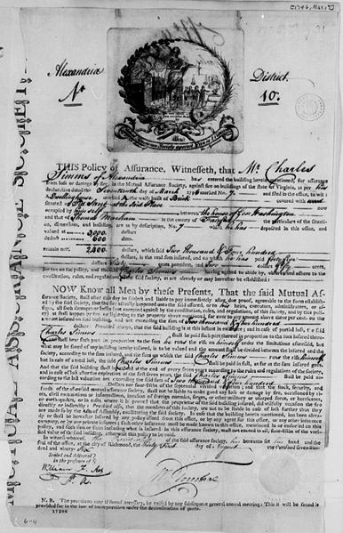
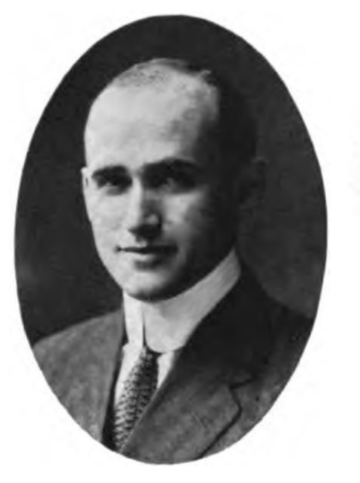
Reusing copyright material
; images: http://commons.wikimedia.org/wiki/File:Insurance_contract.jpg & http://upload.wikimedia.org/wikipedia/commons/7/75/Samuel_Goldwyn_001.jpg

Slide 27
Reusing copyright material
Q When can you use other people’s content?
A Old
Public Domain
Public sector data
Permission
Licences
Exceptions
Links
; image: https://www.picpedia.org/highway-signs/p/prevent.html

Slide 28
Reusing copyright material
Q When can you use other people’s content?
A Old
Public Domain
Public sector data
Permission
Licences
Exceptions
Links
; image: https://www.picpedia.org/highway-signs/p/prevent.html

Slide 29

Reusing copyright material
Q When can you use other people’s content?
A Old
Public Domain
Public sector data
Permission
Licences
Exceptions
Links
; image: http://www.ifrro.org/members/irish-copyright-licensing-agency used by kind permission of the ICLA

Slide 30
Reusing copyright material
Q When can you use other people’s content?
A Old
Public Domain
Public sector data
Permission
Licences
Exceptions
Links
; image: https://www.picpedia.org/highway-signs/p/prevent.html

Slide 31
Reusing copyright material
Q When can you use other people’s content?
A Old
Public Domain
Public sector data
Permission
Licences
Exceptions
Links
; image: https://www.picpedia.org/highway-signs/p/prevent.html

Slide 32
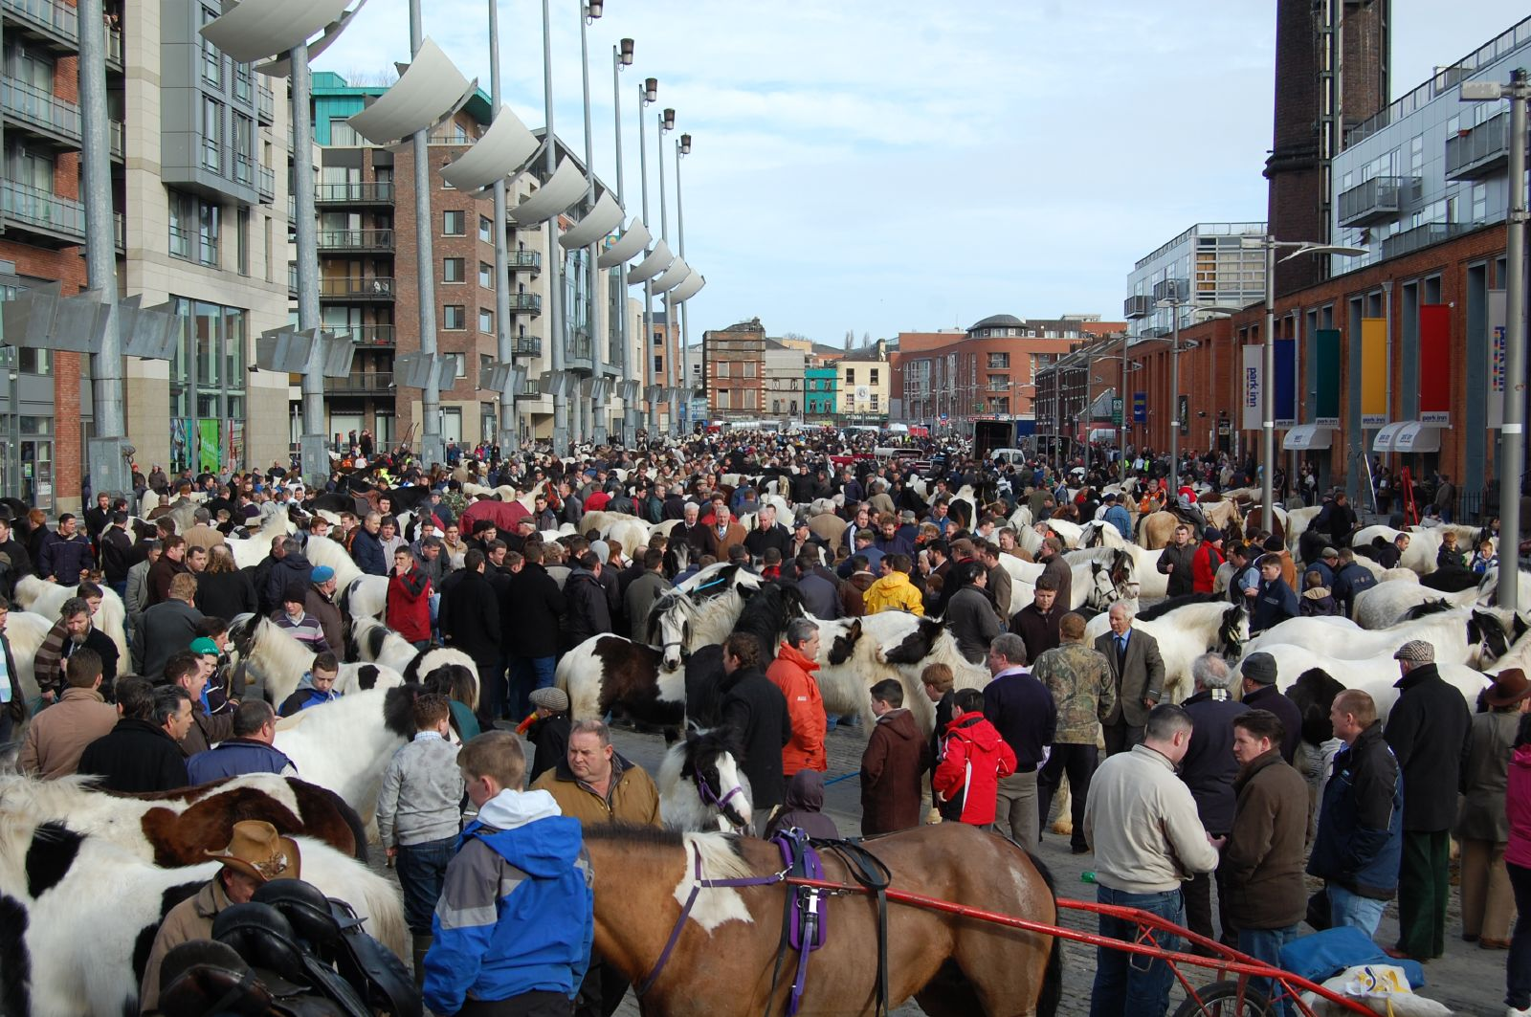
Part II Chapter 6 CRRA
Fair
Dealing
; image: http://www.cearta.ie/wp-content/uploads/2012/01/JoyceNWM.jpg

Slide 33
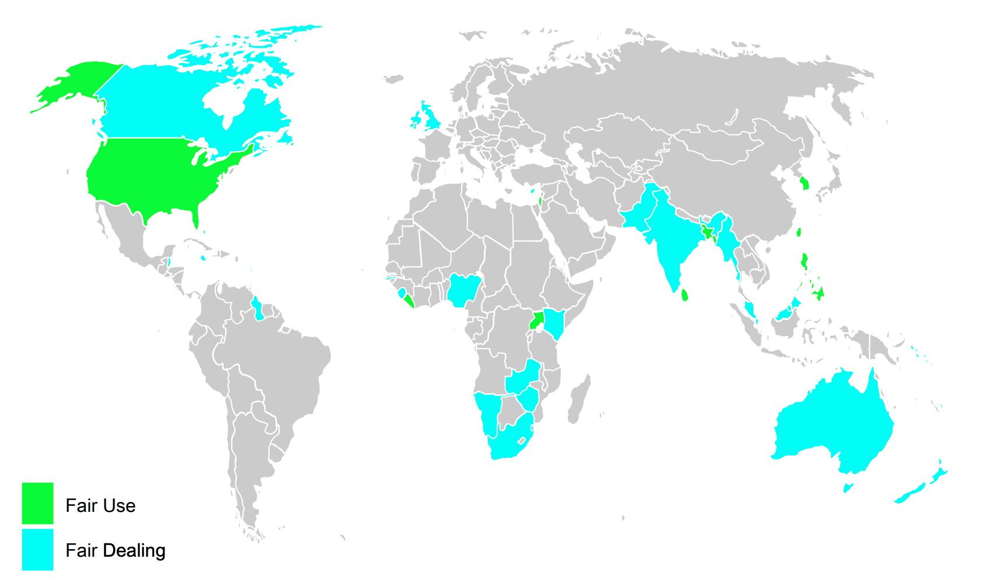

Fair Use v Fair Dealing
; image:
via https://www.arl.org/resources/maps-of-fair-use-and-fair-dealing-around-the-world/
Based on Band & Gerafi, The Fair Use/Fair Dealing Handbook; map prepared by Amy Bulgrien

Slide 34
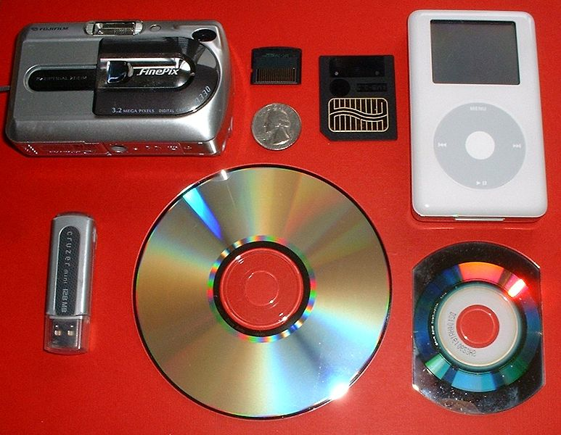
No exception for format shifting
; image:
http://en.wikipedia.org/wiki/File:PersonalStorageDevices.agr.jpg (CC BY-SA 3.0 )

Slide 35
Reusing copyright material
Q When can you use other people’s content?
A Old
Public Domain
Public sector data
Permission
Licences
Exceptions
Links
; image: https://www.picpedia.org/highway-signs/p/prevent.html

Slide 36
Reusing copyright material
Q When can you use other people’s content?
A Old
Public Domain
Public sector data
Permission
Licences
Exceptions
Links
; image: https://www.picpedia.org/highway-signs/p/prevent.html

Slide 37

Case C-466/12 Svensson v Retriever Sverige AB
; image: https://www.retrievergroup.com/

Slide 38






What do you do?
Customer
Uploader Downloader
hosting /
sharing
streaming
/torrents
; image:

Slide 39
Injunctions
Customer
Uploader Downloader
hosting /
sharing
streaming
/torrents
; image:

Slide 40
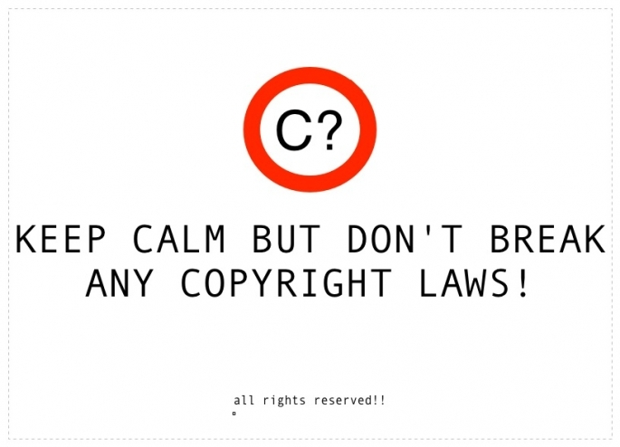
Concluding Advice
; image: http://www.dri.ie/public-lecture-copyright-digital-arts-and-humanities-dr-eoin-odell

Slide 41

Censorship
; image: via https://www.drooker.com/illustrations

Slide 42
Censorship
Private
; image: via https://www.drooker.com/illustrations

Slide 43
Censorship
Public
; image: via https://www.drooker.com/illustrations

Slide 44
Censorship
Self
; image: via https://www.drooker.com/illustrations

Slide 45
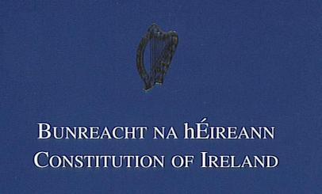
Freedom of Expression
; image: https://commons.wikimedia.org/wiki/File:Constitution_of_Ireland,_Bunreacht_na_hEireann,
_1937,_government_of_Ireland.jpg

Slide 46
Freedom of Expression: Article 40(6)
1° The State guarantees liberty for the exercise of the following rights,
(i ) The right of the citizens to express freely their convictions and opinions.

Slide 47
Freedom of Expression: Article 40(6)
1° The State guarantees liberty for the exercise of the following rights, subject to public order and morality: –
(i ) The right of the citizens to express freely their convictions and opinions.

Slide 48
Freedom of Expression: Article 40(6)
1° The State guarantees liberty for the exercise of the following rights, subject to public order and morality: –
(i ) The right of the citizens to express freely their convictions and opinions.
The education of public opinion being, however, a matter of such grave import to the common good, the State shall endeavour to ensure that organs of public opinion, such as the radio, the press, the cinema, while preserving their rightful liberty of expression, including criticism of Government policy, shall not be used to undermine public order or morality or the authority of the State.
The publication or utterance of blasphemous, seditious or indecent matter is an offence which shall be punishable in accordance with law.

Slide 49
Freedom of Expression: Article 40(6)
1° The State guarantees liberty for the exercise of the following rights, subject to public order and morality: –
(i ) The right of the citizens to express freely their convictions and opinions.
The education of public opinion being, however, a matter of such grave import to the common good, the State shall endeavour to ensure that organs of public opinion, such as the radio, the press, the cinema, while preserving their rightful liberty of expression, including criticism of Government policy, shall not be used to undermine public order or morality or the authority of the State.
The publication or utterance of blasphemous, seditious or indecent matter is an offence which shall be punishable in accordance with law.

Slide 50
Freedom of Expression: Article 40(6)
1° The State guarantees liberty for the exercise of the following rights, subject to public order and morality: –
(i ) The right of the citizens to express freely their convictions and opinions.
The education of public opinion being, however, a matter of such grave import to the common good, the State shall endeavour to ensure that organs of public opinion, such as the radio, the press, the cinema, while preserving their rightful liberty of expression, including criticism of Government policy, shall not be used to undermine public order or morality or the authority of the State.
The publication or utterance of blasphemous, seditious or indecent matter is an offence which shall be punishable in accordance with law.

Slide 51

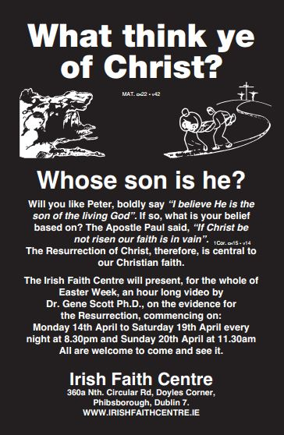
Murphy v IRTC
[1991] 1 IR 120, [1998] 2 ILRM 360
; images: http://irishfaithcentre.ie/ressurrection.html

Slide 52

Murphy v IRTC
[1991] 1 IR 120, [1998] 2 ILRM 360
Restriction
; images: http://irishfaithcentre.ie/ressurrection.html & http://radiowaves.fm/ire/radiowavesnews/wp-content/uploads/sites/2/2020/12/1988-12December-13-Irish-Independent.jpg

Slide 53
Murphy v IRTC
[1991] 1 IR 120, [1998] 2 ILRM 360
Restriction
Right
; images: http://irishfaithcentre.ie/ressurrection.html

Slide 54
Freedom of Expression: Article 40(6)
1° The State guarantees liberty for the exercise of the following rights, subject to public order and morality: –
(i ) The right of the citizens to express freely their convictions and opinions.
The education of public opinion being, however, a matter of such grave import to the common good, the State shall endeavour to ensure that organs of public opinion, such as the radio, the press, the cinema, while preserving their rightful liberty of expression, including criticism of Government policy, shall not be used to undermine public order or morality or the authority of the State.
The publication or utterance of blasphemous, seditious or indecent matter is an offence which shall be punishable in accordance with law.

Slide 55
Freedom of Expression: Article 40(6)
1° The State guarantees liberty for the exercise of the following rights, subject to public order and morality: –
(i ) The right of the citizens to express freely their convictions and opinions.
The education of public opinion being, however, a matter of such grave import to the common good, the State shall endeavour to ensure that organs of public opinion, such as the radio, the press, the cinema, while preserving their rightful liberty of expression, including criticism of Government policy, shall not be used to undermine public order or morality or the authority of the State.
The publication or utterance of blasphemous, seditious or indecent matter is an offence which shall be punishable in accordance with law.

Slide 56
Murphy v IRTC
[1991] 1 IR 120, [1998] 2 ILRM 360
Restriction
Right
Reason
; images: http://irishfaithcentre.ie/ressurrection.html

Slide 57
Freedom of Expression: Article 40(6)
1° The State guarantees liberty for the exercise of the following rights, subject to public order and morality: –
(i ) The right of the citizens to express freely their convictions and opinions.
The education of public opinion being, however, a matter of such grave import to the common good, the State shall endeavour to ensure that organs of public opinion, such as the radio, the press, the cinema, while preserving their rightful liberty of expression, including criticism of Government policy, shall not be used to undermine public order or morality or the authority of the State.
The publication or utterance of blasphemous, seditious or indecent matter is an offence which shall be punishable in accordance with law.

Slide 58
Freedom of Expression: Article 40(6)
1° The State guarantees liberty for the exercise of the following rights, subject to public order and morality: –
(i ) The right of the citizens to express freely their convictions and opinions.
The education of public opinion being, however, a matter of such grave import to the common good, the State shall endeavour to ensure that organs of public opinion, such as the radio, the press, the cinema, while preserving their rightful liberty of expression, including criticism of Government policy, shall not be used to undermine public order or morality or the authority of the State.
The publication or utterance of blasphemous, seditious or indecent matter is an offence which shall be punishable in accordance with law.

Slide 59
Freedom of Expression: Article 40(6)
1° The State guarantees liberty for the exercise of the following rights, subject to public order and morality: –
(i ) The right of the citizens to express freely their convictions and opinions.
The education of public opinion being, however, a matter of such grave import to the common good, the State shall endeavour to ensure that organs of public opinion, such as the radio, the press, the cinema, while preserving their rightful liberty of expression, including criticism of Government policy, shall not be used to undermine public order or morality or the authority of the State.
The publication or utterance of blasphemous, seditious or indecent matter is an offence which shall be punishable in accordance with law.
Common Good

Slide 60
Freedom of Expression: Article 40(6)
1° The State guarantees liberty for the exercise of the following rights, subject to public order and morality: –
(i ) The right of the citizens to express freely their convictions and opinions.
The education of public opinion being, however, a matter of such grave import to the common good, the State shall endeavour to ensure that organs of public opinion, such as the radio, the press, the cinema, while preserving their rightful liberty of expression, including criticism of Government policy, shall not be used to undermine public order or morality or the authority of the State.
The publication or utterance of blasphemous, seditious or indecent matter is an offence which shall be punishable in accordance with law.
Common Good etc etc

Slide 61
Murphy v IRTC
[1991] 1 IR 120, [1998] 2 ILRM 360
Restriction
Right
Reason
Review
; images: http://irishfaithcentre.ie/ressurrection.html

Slide 62
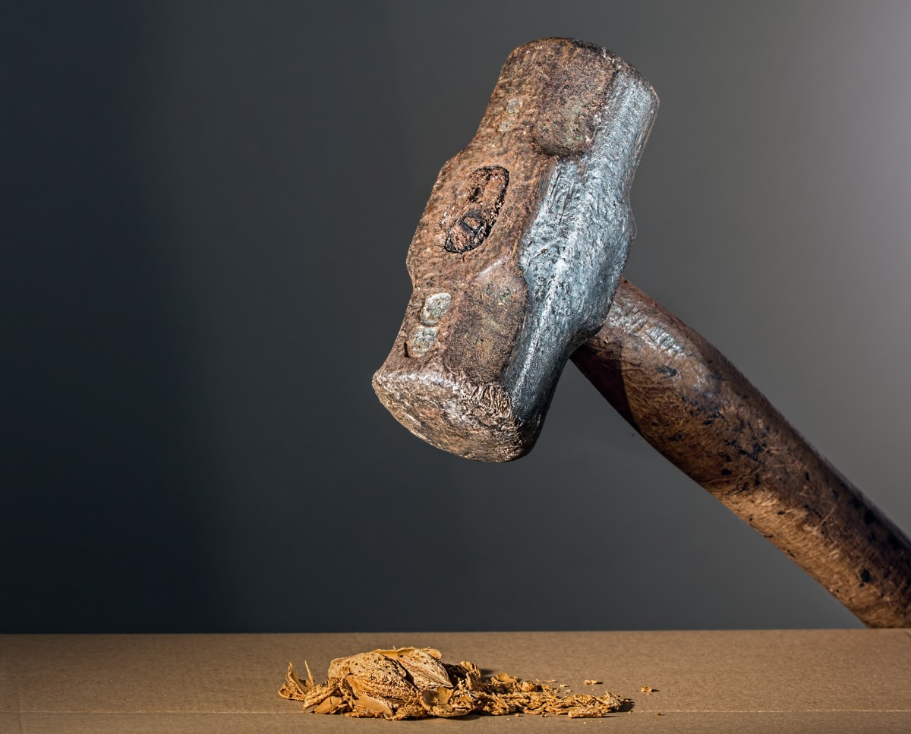
Review
Proportionality
; images: https://pxhere.com/en/photo/895059

Slide 63
Murphy v IRTC
[1991] 1 IR 120, [1998] 2 ILRM 360
4 Rs
Restriction
Right
Reason
Review
; images: http://irishfaithcentre.ie/ressurrection.html

Slide 64
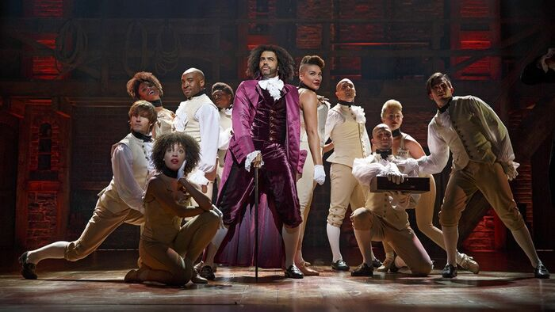
What is this?
; image: https://hamiltonmusical.fandom.com/wiki/What%27d_I_Miss%3F/

Slide 65
What I’d miss?
; image: https://hamiltonmusical.fandom.com/wiki/What%27d_I_Miss%3F/

Slide 66

Any questions?
; image: https://pixabay.com/illustrations/q-and-a-question-answer-q-sign-2453376/

